Slide 1
A graph convolutional neural network for classification of building patterns using spatial vector data
RA - MD. Sabbir Hossain
ST- Ehsanur Rahman Rhythm
Mahdi Hasan Bhuiyan (20101541)

Slide 2
Motivation
Traditional machine learning algorithms struggle with spatial data
Graph Convolutional Neural Networks (GCNs) can incorporate spatial relationships between features
Building pattern classification is an important task in urban planning and architecture

Slide 3
Dataset
The dataset consists of building polygons
No information is provided about the dataset beyond this

Slide 4
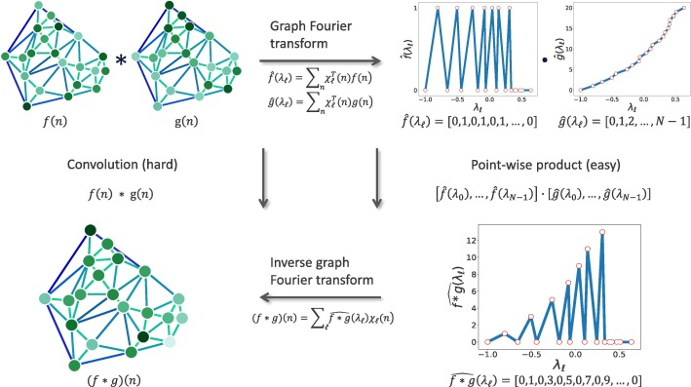
A graph is constructed from the building polygons, where nodes represent building centroids and edges represent adjacency relationships
Node features include building area, perimeter, and shape complexity
Edge features include distance and bearing between building centroids
The GCN consists of multiple graph convolutional layers, each with a nonlinear activation function

Slide 5
Baseline Models
Two baseline models are compared against the proposed GCN architecture: Random Forest and Support Vector Machine (SVM)

Slide 6
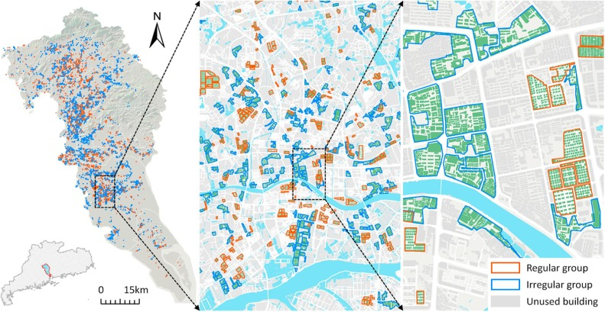
The proposed GCN architecture achieves better performance than the baseline models in terms of accuracy, precision, recall, and F1 score
Statistical significance is demonstrated using a paired t-test
The results suggest that the incorporation of spatial relationships using GCNs improves building pattern classification

Slide 7
Discussion
The proposed GCN architecture is well-explained and achieves better performance than baseline models
Limitations include the lack of information on the dataset used and the absence of comparisons against other state-of-the-art approaches
Future work could include applying the proposed GCN architecture to other spatial classification tasks

Slide 8
Conclusion
The paper proposes a GCN architecture for building pattern classification using spatial vector data
The experimental results demonstrate that the proposed GCN outperforms baseline models
The proposed GCN can incorporate spatial relationships between features, making it a useful tool for urban planning and architecture

